Slide 1





Ministry of Rural Development
DAY-NRLM
Lakhpati Didi: Orientation for VO/CLF

Slide 2

TRAINING OBJECTIVES
2
Significance and Role of CRPs in making Didis Lakhpati
Orienting on Lakhpati Didi
1
Understanding livelihoods
Strategy of lakhpati livelihood planning
Process for livelihood plan
Steps for livelihoods planning with Didis
Point of reference for CRPs during plan preparation
Lakhpati Livelihood Planning tool
Role of VO
Aajeevika register
3

Slide 3
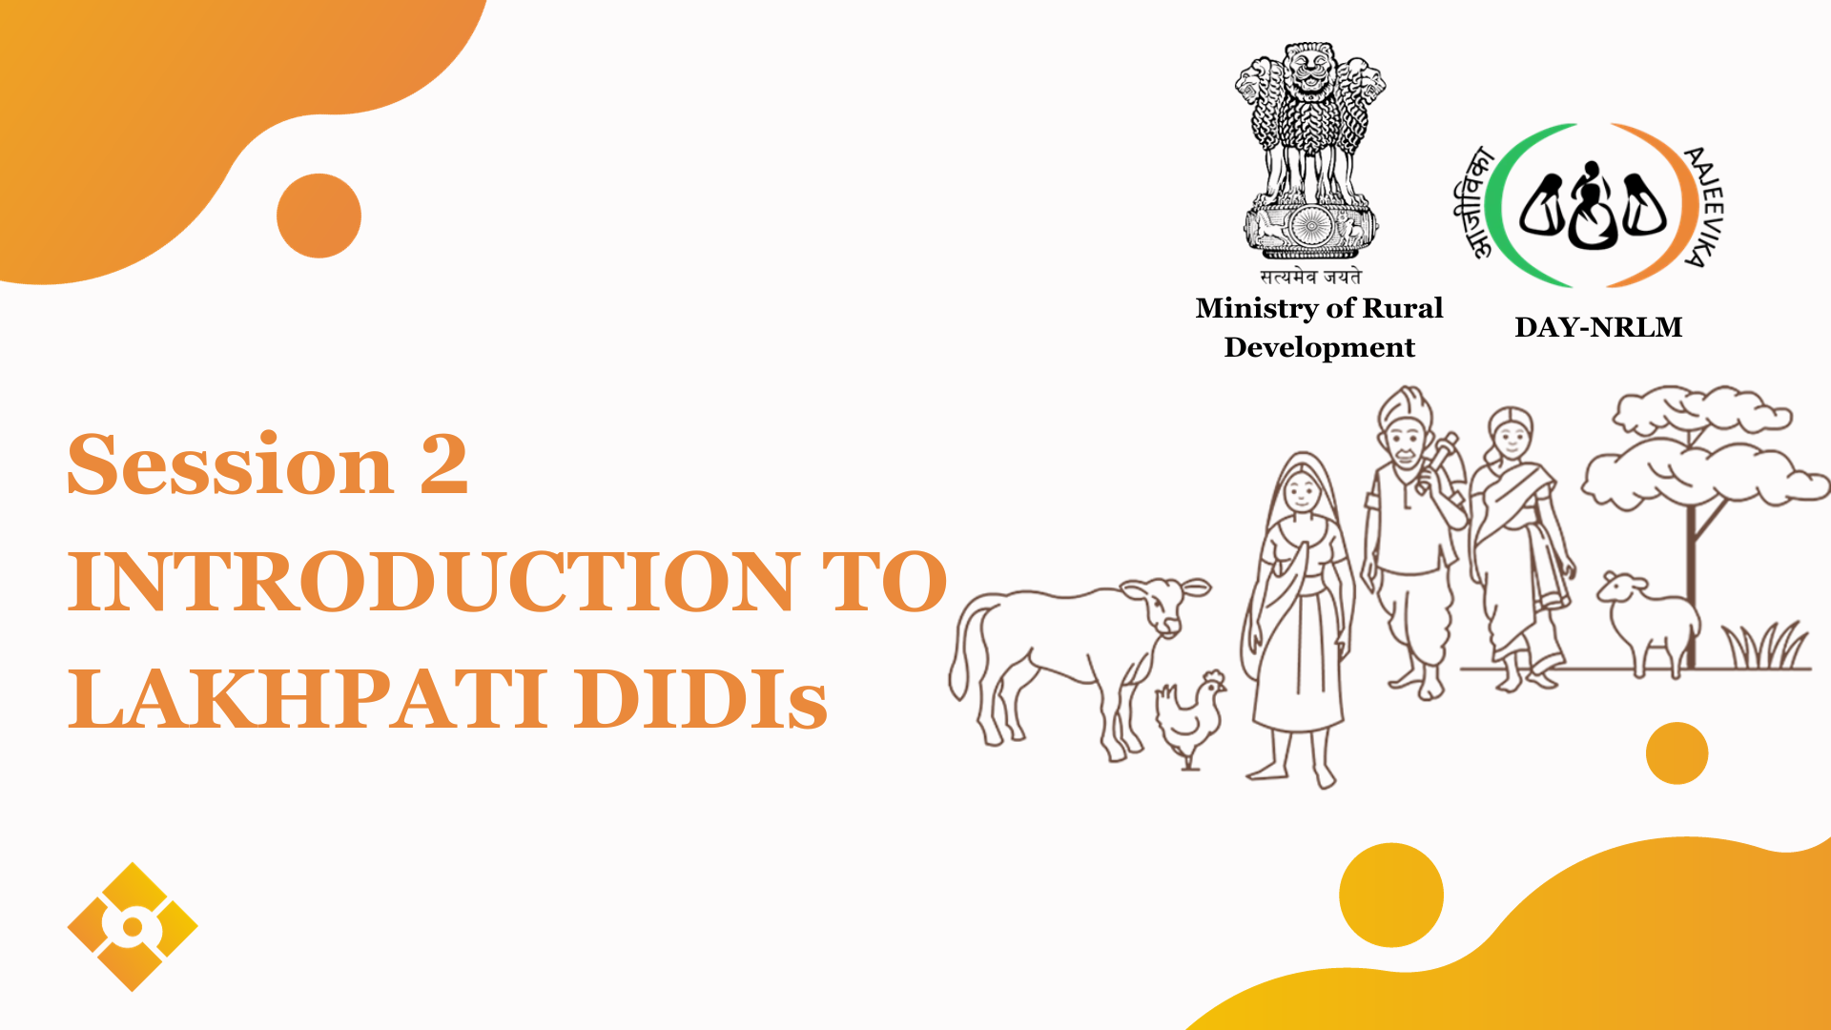



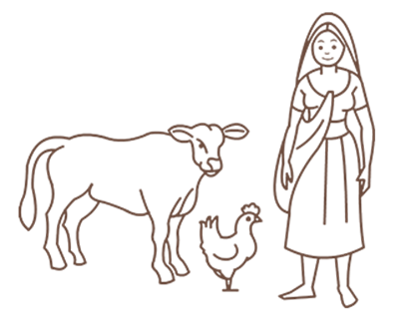

Ministry of Rural Development
DAY-NRLM
Session 2
INTRODUCTION TO LAKHPATI DIDIs

Slide 4


WHAT WILL WE DISCUSS?
1.Hon’ble PMs announcement
2.Who is a Lakhpati Didi
3.Survey Findings in 2022-23
4.Identification of Potential Lakhpati Didis
5.Roles and Activities of CRPs

Slide 5




SHG Member with annual household income
more than 1 lakh
Lakhpati
Didi
Average Monthly Income of ₹10,000 or more sustained for
at least four Agricultural Seasons/Business cycles

Slide 6
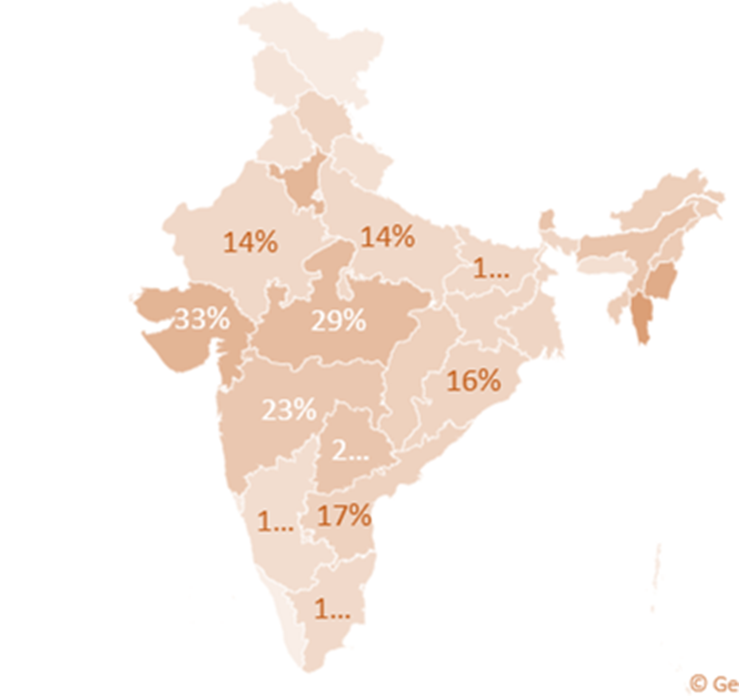
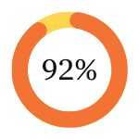
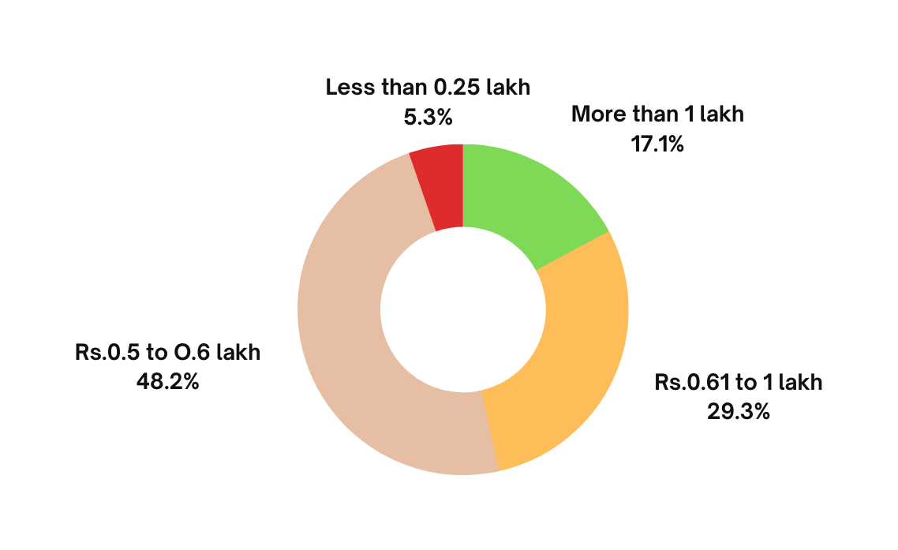
LAKHPATI SURVEY 2022-23
9 Crore SHG Households
8.34 Cr Surveyed
Lakhpati Didis

Slide 7
POTENTIAL LAKHPATI DIDI
CRITERIA
  SHGs who have completed minimum 2 years
  SHGs who have availed CIF
  SHGs who are the beneficiaries of livelihood intervention from DAY-NRLM
SUGGESTIONS
  Already Lakhpati Didi may also need handholding for some time, Max 25% of such Didis can be supported
  CRPs to be linked with each identified Lakhpati Didi who will be ensuring the transformation

Slide 8


CRP: ROLE AS PILLARS OF CONTINUOUS SUPPORT
Facilitator
Troubleshooter
Capacity Builder
Monitoring
Personalized guidance, Plan preparation tailored to each member and collation.
Connect with schemes, progs, institutions
Navigating through challenges
Data recording and reporting,
Continual oversight, course correction
Enhancing skills and knowledge of members

Slide 9
Understanding Lakhpati Livelihoods
A set of economic activities: self-employment and/or wage-employment/ manufacturing/business, others
By using one’s endowments (human and material)
to generate adequate resources (cash and non-cash)
for meeting the requirements of self and the household,
carried out repeatedly and as such become a way of life.
Ideally
Livelihood keeps a person meaningfully occupied
In a sustainable manner
With Dignity

Slide 10
Strategy for Lakhpati HH Livelihoods planning

Slide 11
5A Framework : An Assessment tool to assist in the selection
of livelihood by HH
Ability (or Skill): Refers to the skills, knowledge, and physical capability of individuals or communities
Access: Involves the availability and reachability of resources, services, and opportunities. This includes access to markets, information, technology, infrastructure, and financial services.
Assets: Assets can be tangible, like land, equipment, livestock, or money, and intangible, such as social networks, reputation, or skills.
Attitude: It includes aspects like willingness to take risks, openness to change, resilience in the face of adversity, and the overall outlook towards life and work.
Affiliation: it refers to the social and institutional relationships and networks that people are part of. Affiliations can influence decision-making and power dynamics within communities

Slide 12

Outside Support Possible out of 5‘A’s
Skill
(Training, Capacity Building/ Exposure etc)
Assets:
Physical Infra supporting livelihoods
Natural and other Assets
Assets
(Equipment, Infrastructure)
Access
(Market and Finance – Loan/ Subsidy etc))
Access:
to Finance loan, schemes,
to Information
to Market
  Direct Access
  Aggregation through PG/PE/FPO etc
Skills:
Ability to take the LH activity up
  Knowledge
  Skills
Notes:
The facilitator will link the previous responses with this slide and categorized the responses of the participants on the previous slide.

Slide 13
Process for Lakhpati Livelihood Planning
Orientation of CLF, VO on Lakhpati Livelihood and their Role
CRP training by Master trainer
SHG members orientation by Lakhpati CRP
Identified Lakhpati Didi’s Livelihood Profile and Plan preparation using identified tools (digitization support by e-CRP)
Consolidation of Plans - SHG, VO and CLF wise
Analysis of Plans
Facilitation for funding and resource support

Slide 14
Steps for Livelihood Planning with Lakhpati Didis
Orientation/Trg of identified SHG members - by CRP at VO meeting
The date and time for preparing Livelihood Plans of Lakhpati Didis- decided during this orientation meeting
The CRP interact with Lakhpati Didis for preparing the Livelihood Plans using the planning tool
Sections in the LH Planning template:
Profile Section
Livelihood activity(ies) identification
Support required for identified Livelihood Activities

Slide 15
https://docs.google.com/spreadsheets/d/12sytH15UkZni43aQvD3J5waHubAG1w-4/edit?usp=sharing&ouid=107469613829008637202&rtpof=true&sd=true
Planning tool

Slide 16
Points of Reference for CRP During Plan Preparation
The Lakhpati Didi must discuss and decide the livelihood activity/ activities in consultation with her family
The existing assets, skills and resources available with the Lakhpati Didi HH must be discussed for each identified activity
The economics (cost - benefit) of each identified activity must be understood by the Didi
CRP must discuss the associated risks (Production risk, market risk, etc) with the SHG HH before finalising the activity
The resources / support required for the identified activities from outside must be identified by Lakhpati Didi and noted by the CRP in the tool
Training materials and Reference Documents must be readily available with the CRP during Plan Preparation.

Slide 17
Role of VO/CLF
Orientation of SHG members in facilitation of CRP
Fix time and date of meeting at SHG household and follow up
Collated data of SHG household planning will be viewed and follow up action on the same through
convergence with line department/GP
Financing for the project through CIF/bank linkage(different schemes like interest subvention, Mudra etc.
Skill enhancement/capacity building with the support of expert agencies
Market linkage for individual/producer collectives
Follow up of the progress in planned activity at SHG household through Aajeevika register with facilitation from CRPand support from SRLM

Slide 18
Aajeevika Register
https://docs.google.com/spreadsheets/d/1LT9ONrnED1pkUJqsmcfzIfuGGLbjSUPN/edit?usp=sharing&ouid=107469613829008637202&rtpof=true&sd=true

